Slide 1






PIZZA SALES
SQL Project

Slide 2



List of contents
Introduction
Database
List Of Tables
Questions
Code

Slide 3



Introduction
This project analyzes pizza sales data to identify trends and improve business strategies.
Let's start our adventure in the world of pizza!

Slide 4


DATABASE
We will work on MySQL Workbench.
Make sure all the required database should be there.
To Analyse the data we have our own database in which all the relevent data
related to sales
Import Data file in MySQL.
We have four tables in our Database.

Slide 5

As we have complex data we have to make the tables in database and then import the data from csv files.

Slide 6
required tables
order_details
orders
pizza_types
pizzas

Slide 7


Calculate the total revenue generated from the pizza’s sales.
Identify the highest price pizza.
questions
Identify the most common pizza size ordered.
List the top 5 most ordered pizza types along with their quantities.
Join the necessary tables to find the total quantity of each pizza category ordered.
Join relevant table to find the category wise distribution of pizzas.
Group the orders by date and calculate the avg numbers of pizzas order per day.
Determine the top 3 most ordered pizza types based on revenue.
Calculate the percentage contribution of each pizza types to total revenue.
Analyze the cumulative revenue generated over time.
Determine the top 3 most ordered pizza types based on revenue for each pizza category.

Slide 8
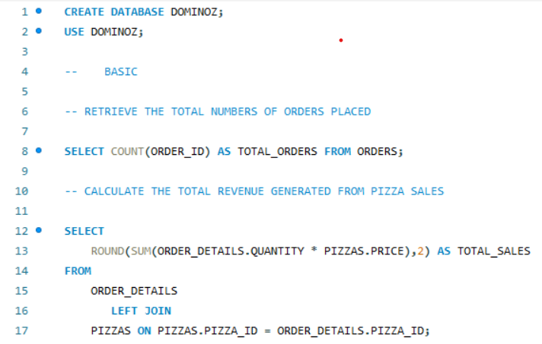

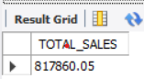
Here we have used the two tables:
order_deatils
pizzas

Slide 9
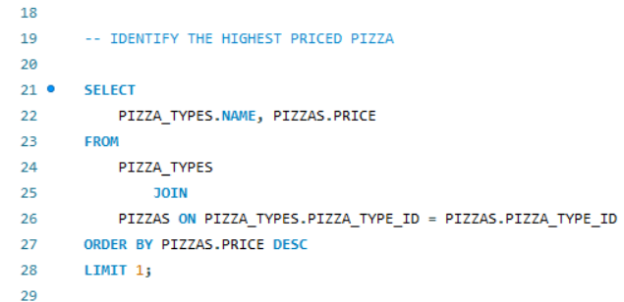
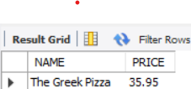
Here we have used the two tables:
pizza_types
pizzas

Slide 10
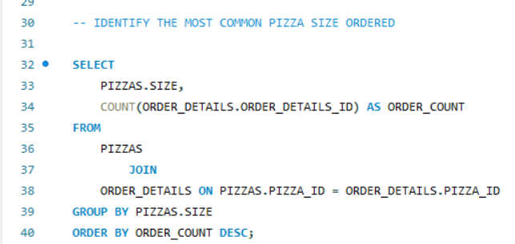
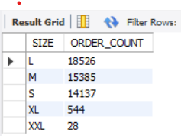
Here we have used the two tables:
order_deatils
pizzas

Slide 11
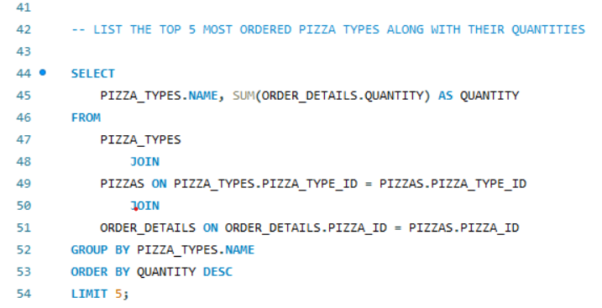
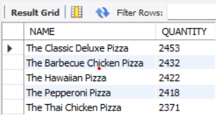
Here we have used the three tables:
order_deatils
pizza_types
pizzas

Slide 12
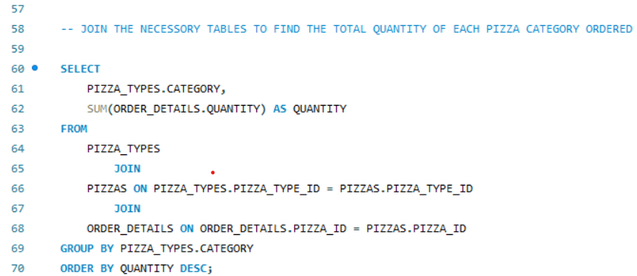
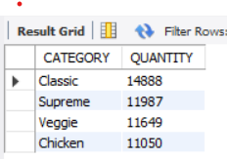
Here we have used the three tables:
order_deatils
pizza_types
pizzas

Slide 13
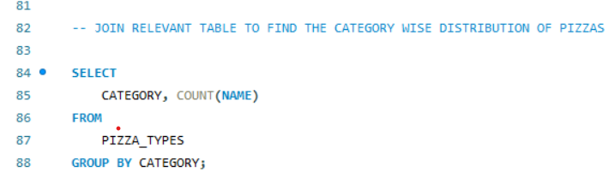
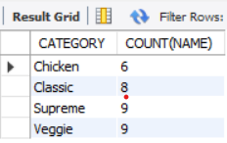
Here we have only single table.

Slide 14
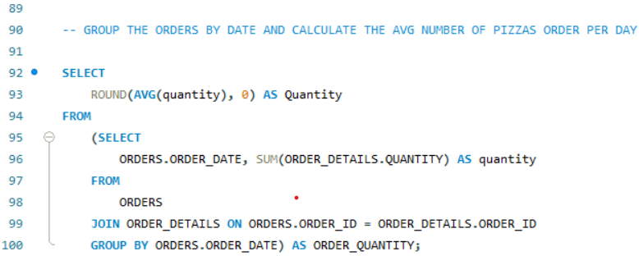
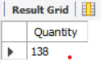
Here we have used the two tables:
order_deatils
orders

Slide 15
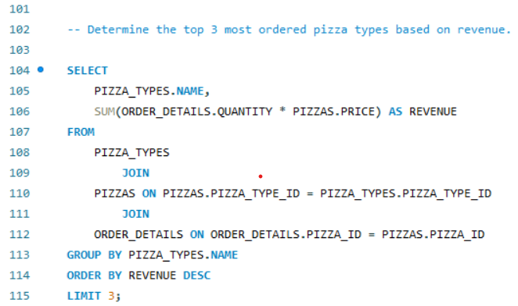
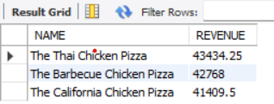
Here we have used the three tables:
order_deatils
pizza_types
pizzas

Slide 16
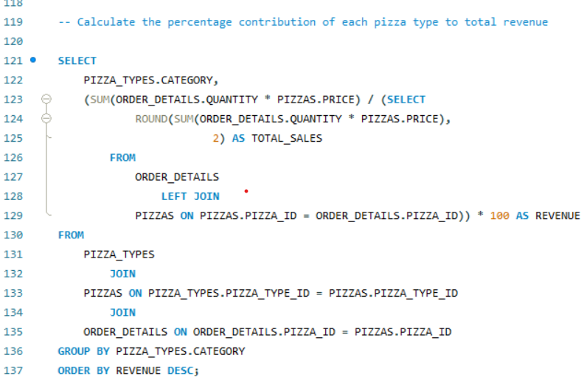
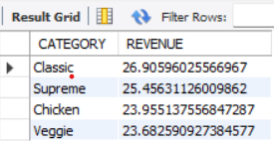
Here we have used the three tables:
order_deatils
pizza_types
pizzas

Slide 17
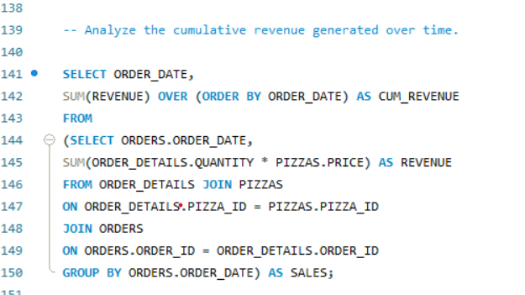
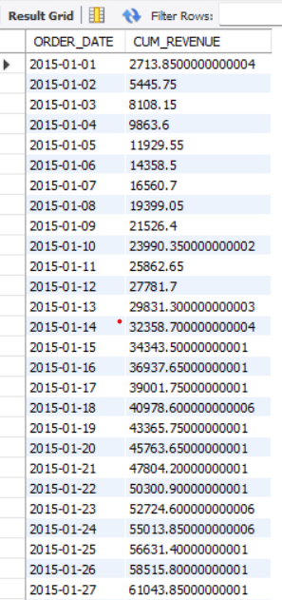
Here we have used the three tables:
order_deatils
orders
pizzas

Slide 18
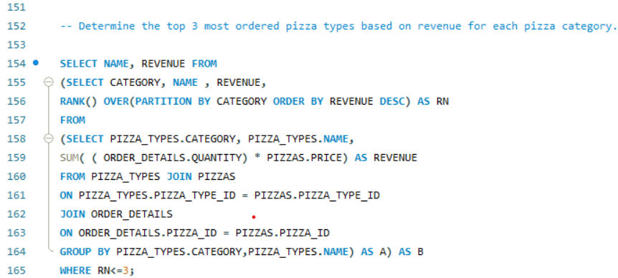
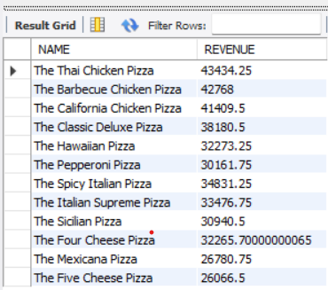
Here we have used the three tables:
order_deatils
pizza_types
pizzas

Slide 19

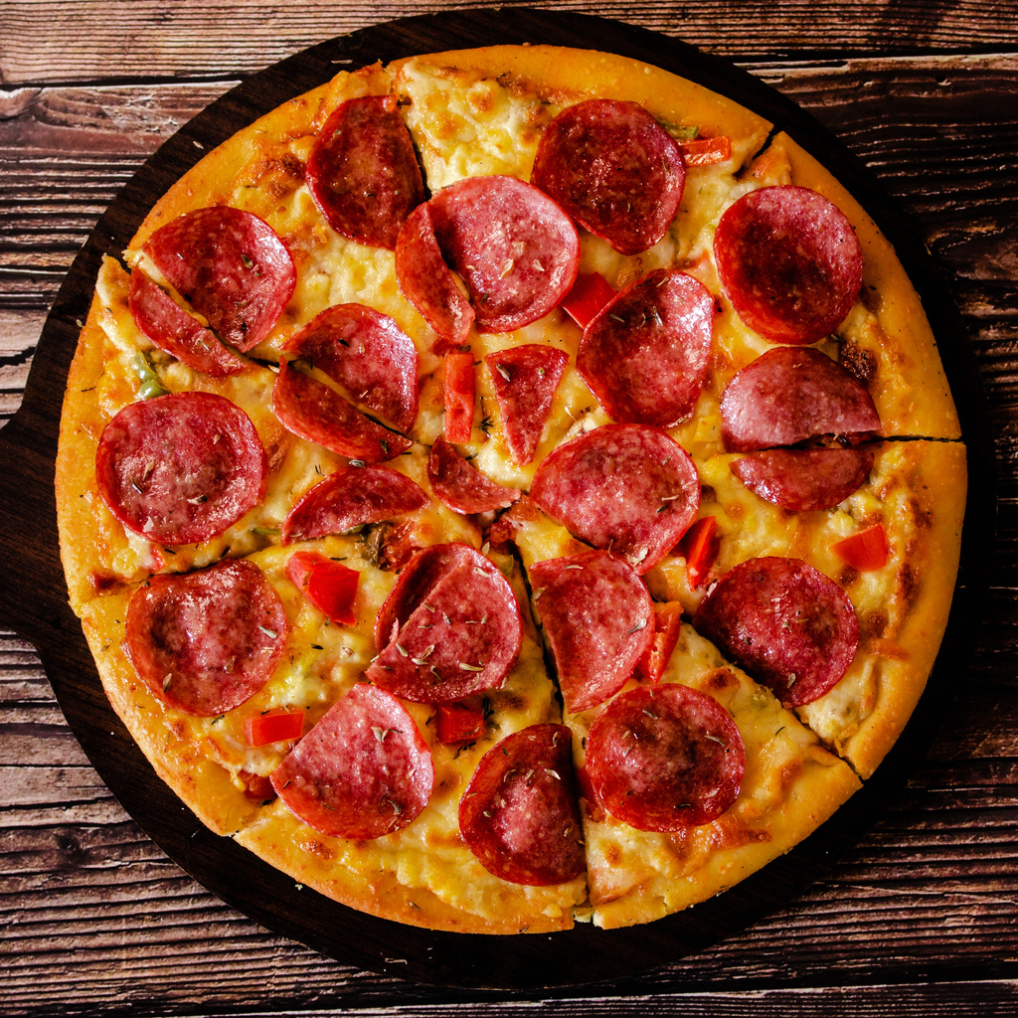
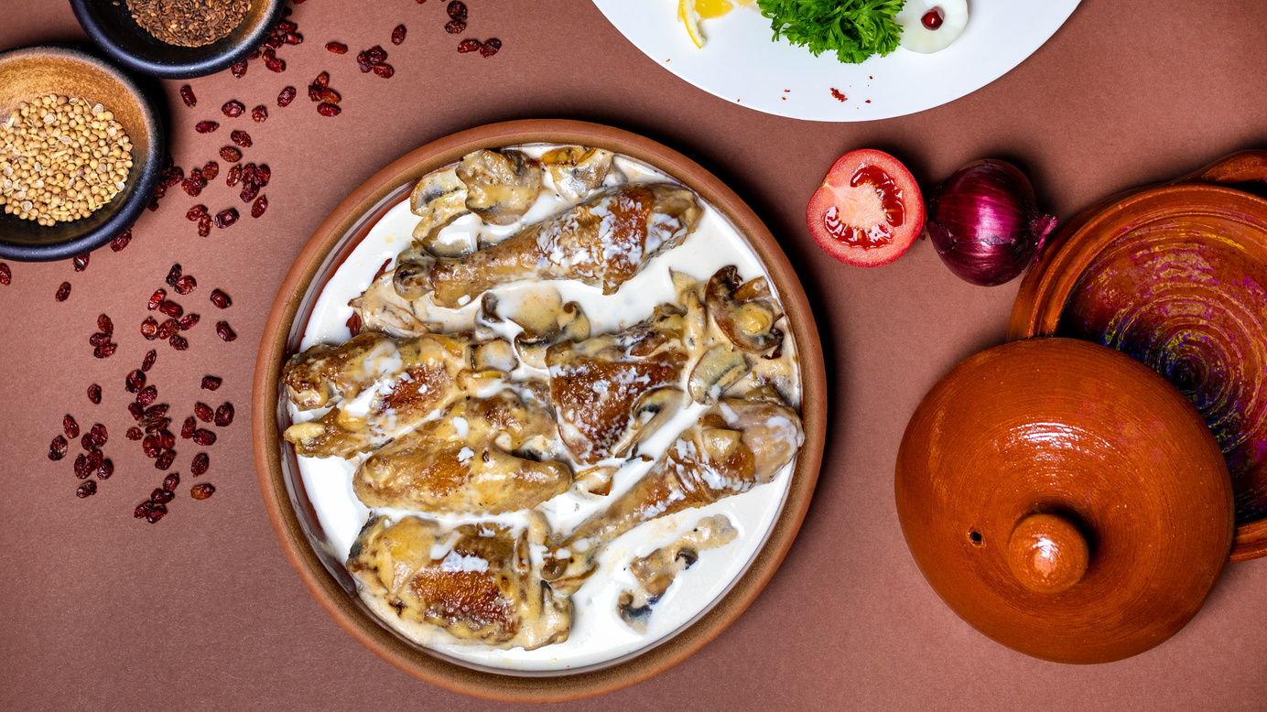

Variations
CLASSIC
SUPREME
BBQ Chicken Pizza
VEGGIE

Slide 20
Thank You

